Slide 1
DIRECT SELLING WORKSHOP
29th - 30th November 2016
4
Presentation
PRODUCT REGISTRATION
&
COSMETICS NOTIFICATION
member of

Slide 2
WHY NEED PRODUCT REGISTRATION AND NOTIFICATION?
PROTECT OUR CONSUMERS
INSTIL CONFIDENCE – A GUARANTEE
PROUD OF HIGH QUALITY PRODUCTS
REGULATORY REQUIREMENTS

Slide 3
THE REGULATIONS
Control of Drug and Cosmetics Regulations 1984
Food Act & Regulations 1983
member of

Slide 4
CONTROL OF DRUG AND COSMETICS REGULATIONS 1984
PRODUCT
National Pharmaceutical Regulatory Agency
CLASSIFICATION
IS IT
FOOD?
PRODUCT
REGISTRATION
REGISTRATION
NOT REQUIRED
member of

Slide 5
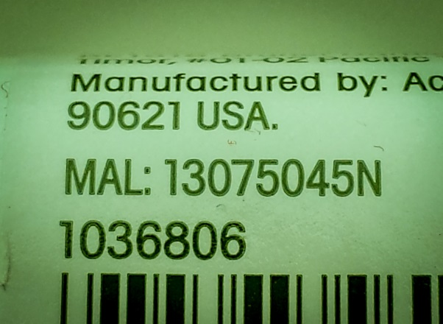
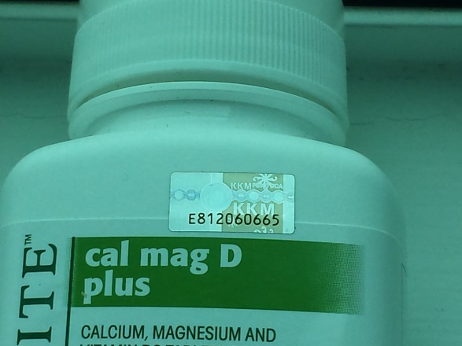
PRODUCT REGISTRATION
THE PROCESS
ASEAN Harmonization by 2020
Traditional Medicine & Health Supplements (THMS)
Pre-Market Approval
Online Registration
For Manufacturers
Good Manufacturing Practices (GMP) certified before submission
For Distributors
Good Distributor Practices (GDP) certified before submission
THE APPROVAL
MAL Number
MAL required for
importation
Hologram
member of

Slide 6
COSMETICS NOTIFICATION
THE PROCESS
ASEAN Harmonization completed – 10% country specific
parallel import restrictions
declaration of animal derivative
Certification of Analysis
Post Market Surveillance
Online Registration
Notification serves as the import license
member of

Slide 7
member of

