Slide 1
DIRECT SELLING
WORKSHOP
29th - 30th November 2016
Presentation 1
OVERVIEW
Of
DIRECT SELLING
Direct Selling
the original
social network
member of

Slide 2
AGENDA
Introduction and what is Direct Selling?
Direct Selling
the original
social network
Direct Selling overview
The Direct Selling Association
of Malaysia (DSAM)
Threats to Direct Selling
The Malaysian Experience
How to identify an Illegal scheme
Question & Answers
member of

Slide 3
‘A vibrant and growing channel of distribution for the marketing of products and services directly to consumers’
World Federation of Direct Selling Associations (WFDSA)
DIRECT
SELLING
SINGLE LEVEL
MARKETING (SLM)
MAIL
ORDER (MO)
MULTI LEVEL
MARKETING
(MLM)
member of

Slide 4
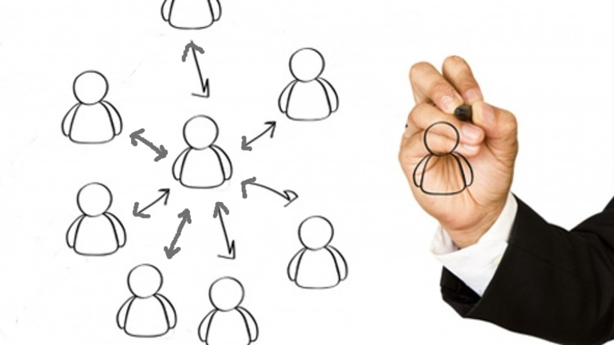
SINGLE LEVEL MARKETING
member of

Slide 5
MULTI-LEVEL MARKETING
member of

Slide 6
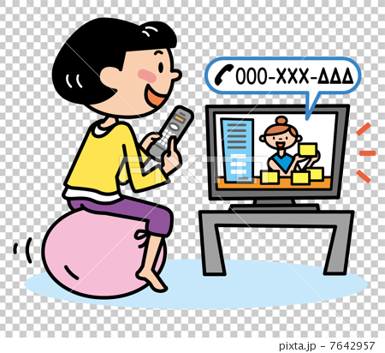
MAIL ORDER
member of

Slide 7
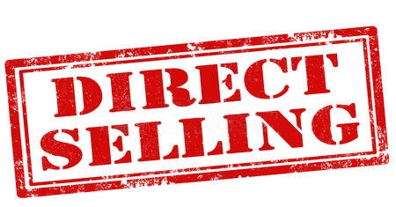
not
not to be confused with
member of

Slide 8
AGENDA
Introduction and what is Direct Selling?
Direct Selling overview
Direct Selling
the original
social network
The Direct Selling Association
of Malaysia (DSAM)
Threats to Direct Selling
The Malaysian Experience
How to identify an Illegal scheme
Question & Answers
member of

Slide 9
DIRECT SELLING GLOBAL
Market size : + 7.7%
USD 171
2014
USD 184
2015
(BILLION DOLLARS)
Independent Distributors : + 4.4%
2014 : 100 million
2015 : 103 million
member of

Slide 10
GLOBAL DISTRIBUTION
member of

Slide 11
GLOBAL POSITIONS 2015
1 United States
2 China
3 Korea
4 Germany
5 Japan
6 Brazil
7 Mexico
8 France
9 Malaysia
10 UK
member of

Slide 12
GLOBAL CONTRIBUTION
member of

Slide 13
DIRECT SELLING MALAYSIA
USD 3.01
2013
USD 2.96
2014
(Projected) USD 3.17
2015
(BILLION USD)
Independent Distributors
2014 : 4.25 million
member of

Slide 14
DIRECT SELLING GROWTH
member of

Slide 15
DIRECT SELLING PRODUCTS
Global % in RED
member of

Slide 16
SOCIO-ECONOMIC - GENDER
member of

Slide 17
SOCIO-ECONOMIC - RACE
member of

Slide 18
SOCIO-ECONOMIC - AGE
member of

Slide 19
AGENDA
Introduction and what is Direct Selling?
Direct Selling overview
Direct Selling
the original
social network
The Direct Selling
Association of Malaysia
(DSAM)
Threats to Direct Selling
The Malaysian Experience
How to identify an Illegal scheme
Question & Answers
member of

Slide 20
DSAM BACKGROUND
Founded in 1978, as national trade association aimed at promoting the direct selling industry as well as act as the de facto voice of the industry
Members consist of Multi Level Marketing (MLM) and Single Level Marketing (SLM) companies. Currently has 80 Members
Affiliated to WFDSA in 1981
Logo was change in 2008 to reflect the vibrancy and maturity of the industry.
DSAM
Direct Selling Association of Malaysia
DSAM BACKGROUD
member of

Slide 21
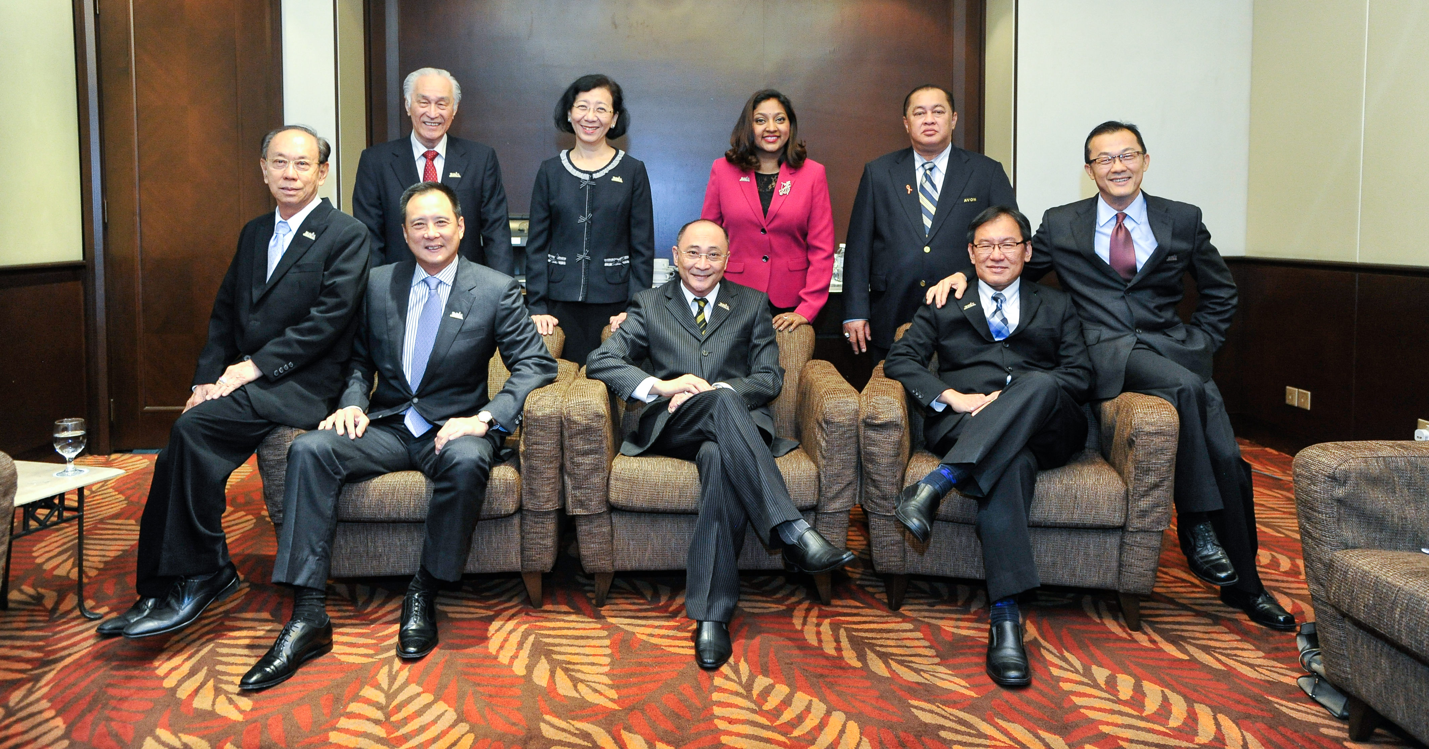
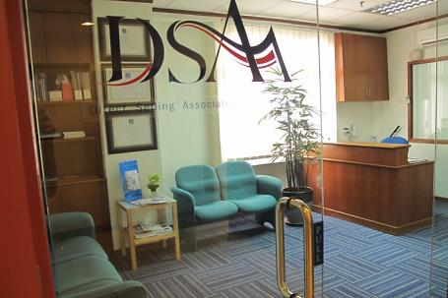
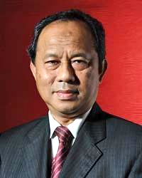
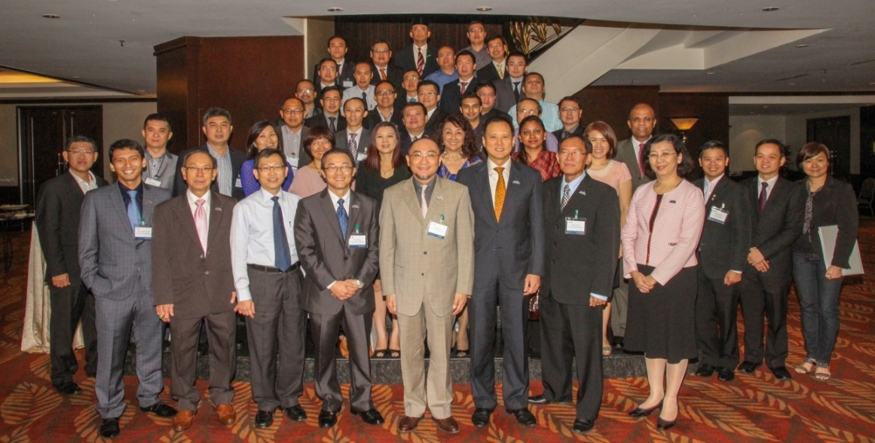
DSAM STRUCTURE
Board
Independent Secretariat
Code Administrator
Tan Sri Dr Sulaiman
Bin Mahbob
Members
Technical & Regulatory
Membership
Sub-Committees
Media & Public Relations
Government
Relations
member of

Slide 22
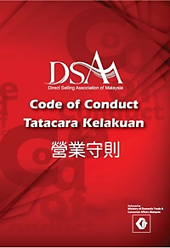
DSAM CODE OF CONDUCT
DSAM CODE OF CONDUCT
First published in 1998
Conforms and exceeds the standards set by the WFDSA.
Endorsed by the Ministry of Domestic Trade, Co-operatives and Consumerism
Contains a structured Complaints Procedure
Independent Code Administrator - Y Bhg Tan Sri Dr Sulaiman Mahbob
Amended in 2008 to reflect the positive changes in the industry
member of

Slide 23
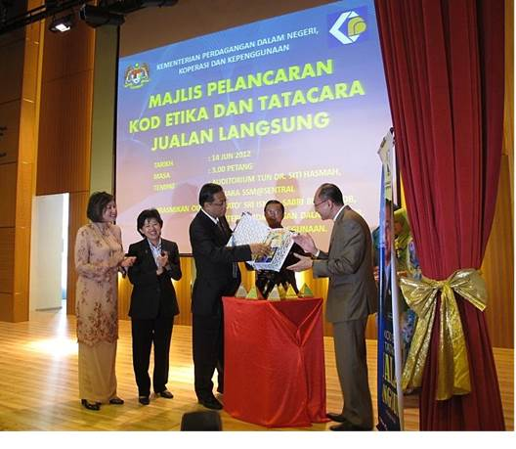
NATIONAL CODE OF ETHICS
DSAM CODE OF CONDUCT
Launched in 2012 by the Ministry of Domestic Trade, Co-operatives and Consumerism
Modelled after DSAM’s Code of Conduct
member of

Slide 24
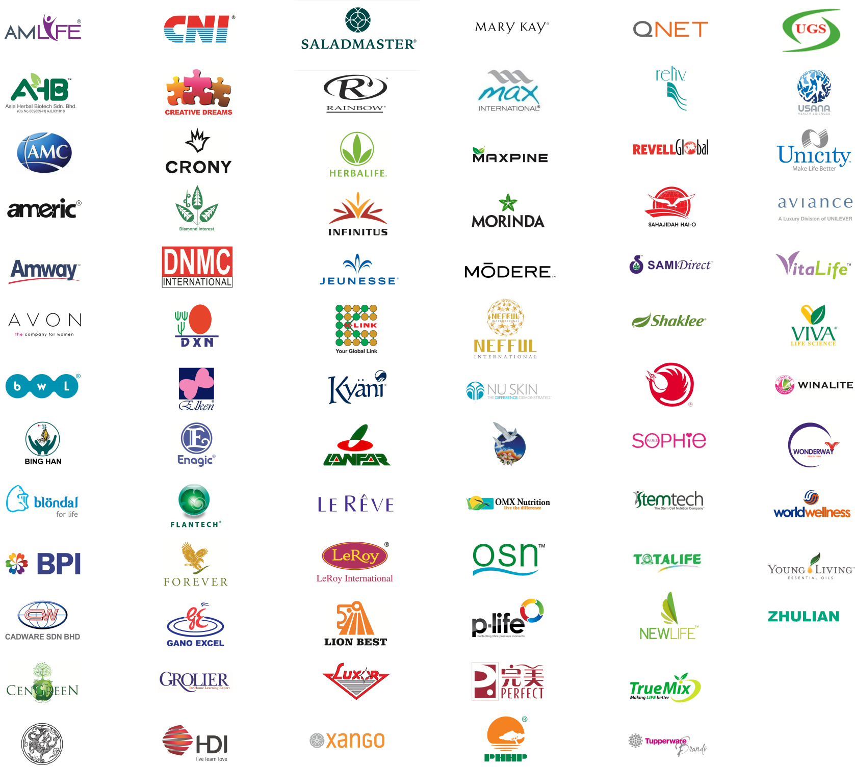
DSAM MEMBERS

Slide 25
WORLD FEDERATION OF DIRECT SELLING ASSOCIATIONS
Founded in 1978, based in Washington DC (USA)
64 National Direct Selling Associations represented in every continent and SELDIA (European Direct Selling Association, representing 28 European National Direct Selling Associations)
Strategic Objectives
Uphold the Direct Selling image | Global Code of Ethics | Standardize processes and structures of WFDSA and DSAs | Integration and alignment of companies

Slide 26
DSAM’S ACTIVE ROLE IN WFDSA
Only Direct Selling association in Malaysia recognised by the world body
Participate in annual Asia-Pacific and Global meetings
Part of WFDSA delegation in dialogues with Regulators eg India, Vietnam
One of the three appointed to sit in the WFDSA Asia Pacific Association Consultative Council
Committee Member of the WFDSA Ethics Committee

Slide 27
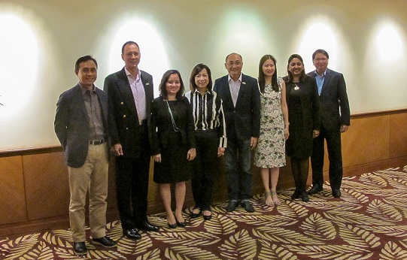
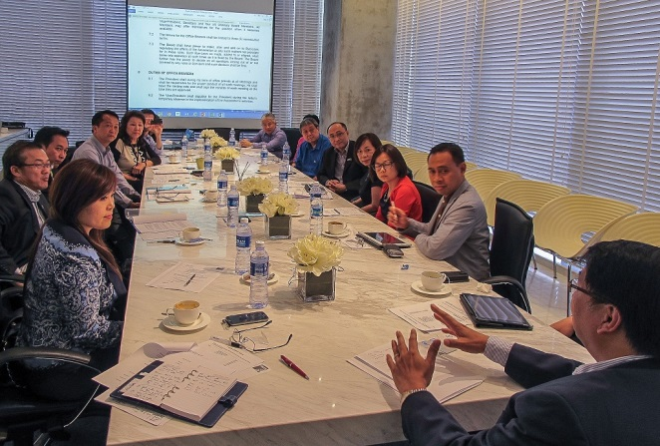
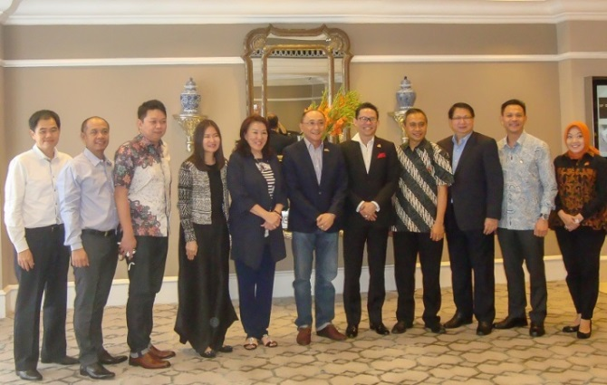
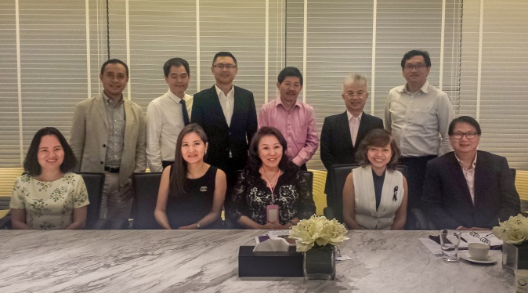
ASEAN DSAs PRESIDENTs
WORKING COMMITTEE
Initiated by DSAM in 2012
Permanent Secretariat in Malaysia
Strengthen cooperation between ASEAN DSAs
Create unprecedented benefits for all Member companies
Sharing and Exchange of knowledge, best practices and market intelligence.
Alerts on illegal schemes
Ease of entry into ASEAN countries
Kuala Lumpur 2012, 2013, 2014, 2015
Singapore 2014
Jakarta 2016
Singapore 2016

Slide 28
Horizontal Logical Flow Of Data
ASEAN DSAs PRESIDENTs WORKING COMMITTEE
Formation of Working Committee and Secretariat
First meeting of ASEAN DSAs Presidents
Consumer Protection, Market Intelligence, etc
2012
2013
2013
2014
2014
onwards
Signing of MOU
Modules on entry into ASEAN Markets
member of

Slide 29
AGENDA
Introduction and what is Direct Selling?
Direct Selling overview?
Direct Selling
the original
social network
The Direct Selling Association
of Malaysia (DSAM)
Threats to Direct Selling
The Malaysian Experience
How to identify an
Illegal scheme
Question & Answers
member of

Slide 30
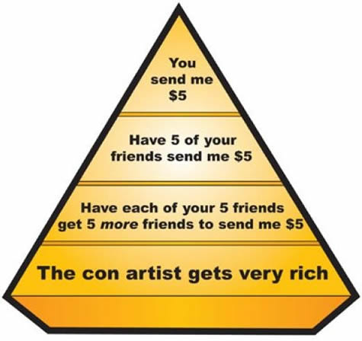
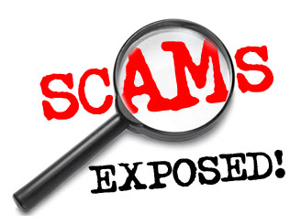
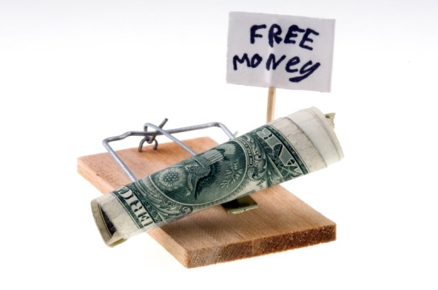
THREATS TO DIRECT SELLING
ASEAN DSAs PRESIDENTs WORKING COMMITTEE
MANY, MANY OTHER
PYRAMID SCHEMES
Download this awesome diagram. Capture your audience’s attention.
1
TEXT
4
2
INVESTMENT SCHEMES
ONLINE SCAMS
3
member of

Slide 31
ILLEGAL SCHEMES (Pyramid, Investment, Deposit taking, etc) in Malaysia
340 Direct Selling
Licenses
Illegal Scams
Numbers unknown!
member of

Slide 32
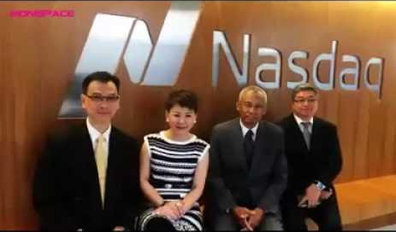
PYRAMID SCHEMES - Creating false trust
member of

Slide 33
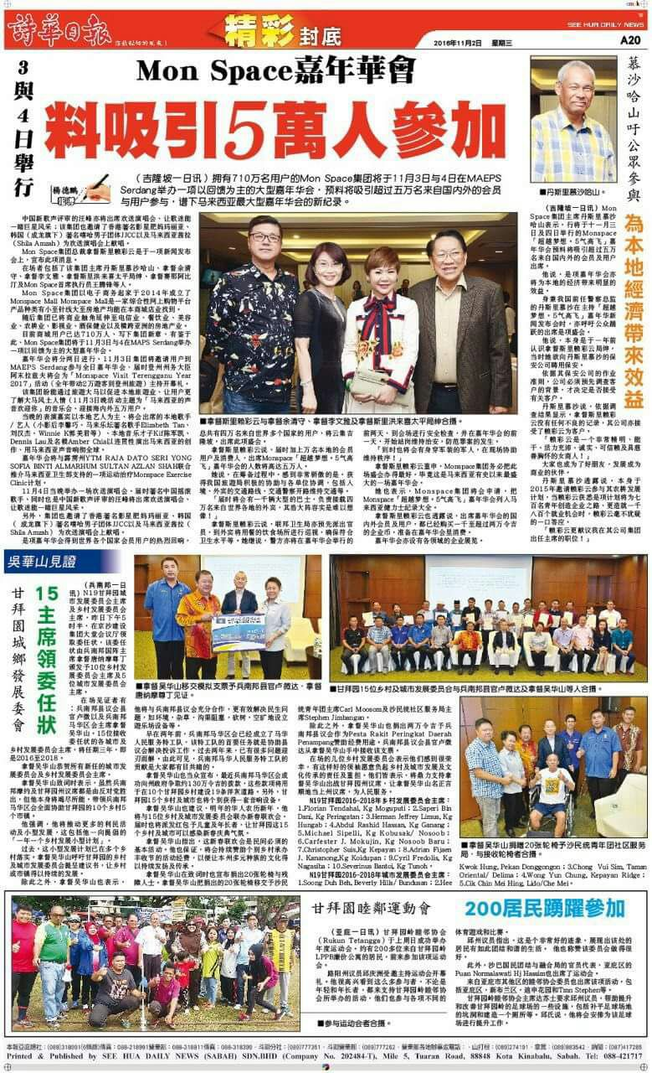
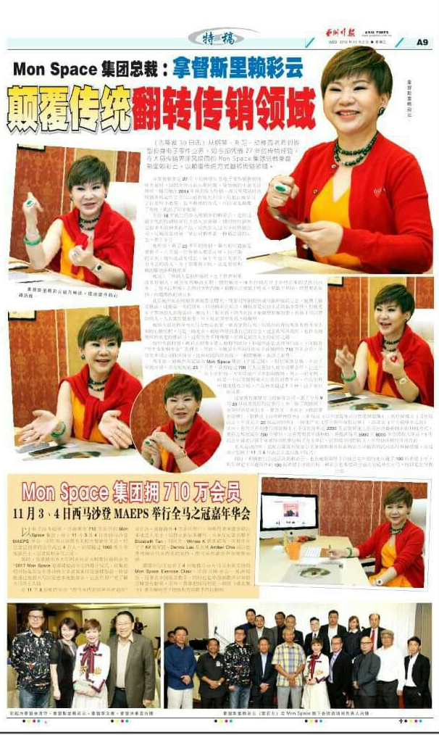
PYRAMID SCHEMES - Creating false trust via advertorials

Slide 34
ILLEGAL INVESTMENT SCHEMES
Central Bank’s Alert List – September 2016
member of

Slide 35
ONLINE SCAMS
ONLINE SCAMS*
Work From Home
Scams
30%
Internet Auction
Scams
22%
20%
Online Dating
Scams
*based on Telenor Group survey in 2016
member of

Slide 36
AGENDA
Introduction and what is Direct Selling?
Direct Selling overview?
Direct Selling
the original
social network
The Direct Selling Association
of Malaysia (DSAM)
Threats to Direct Selling
The Malaysian Experience
How to identify an
illegal scheme
Question & Answers
member of

Slide 37
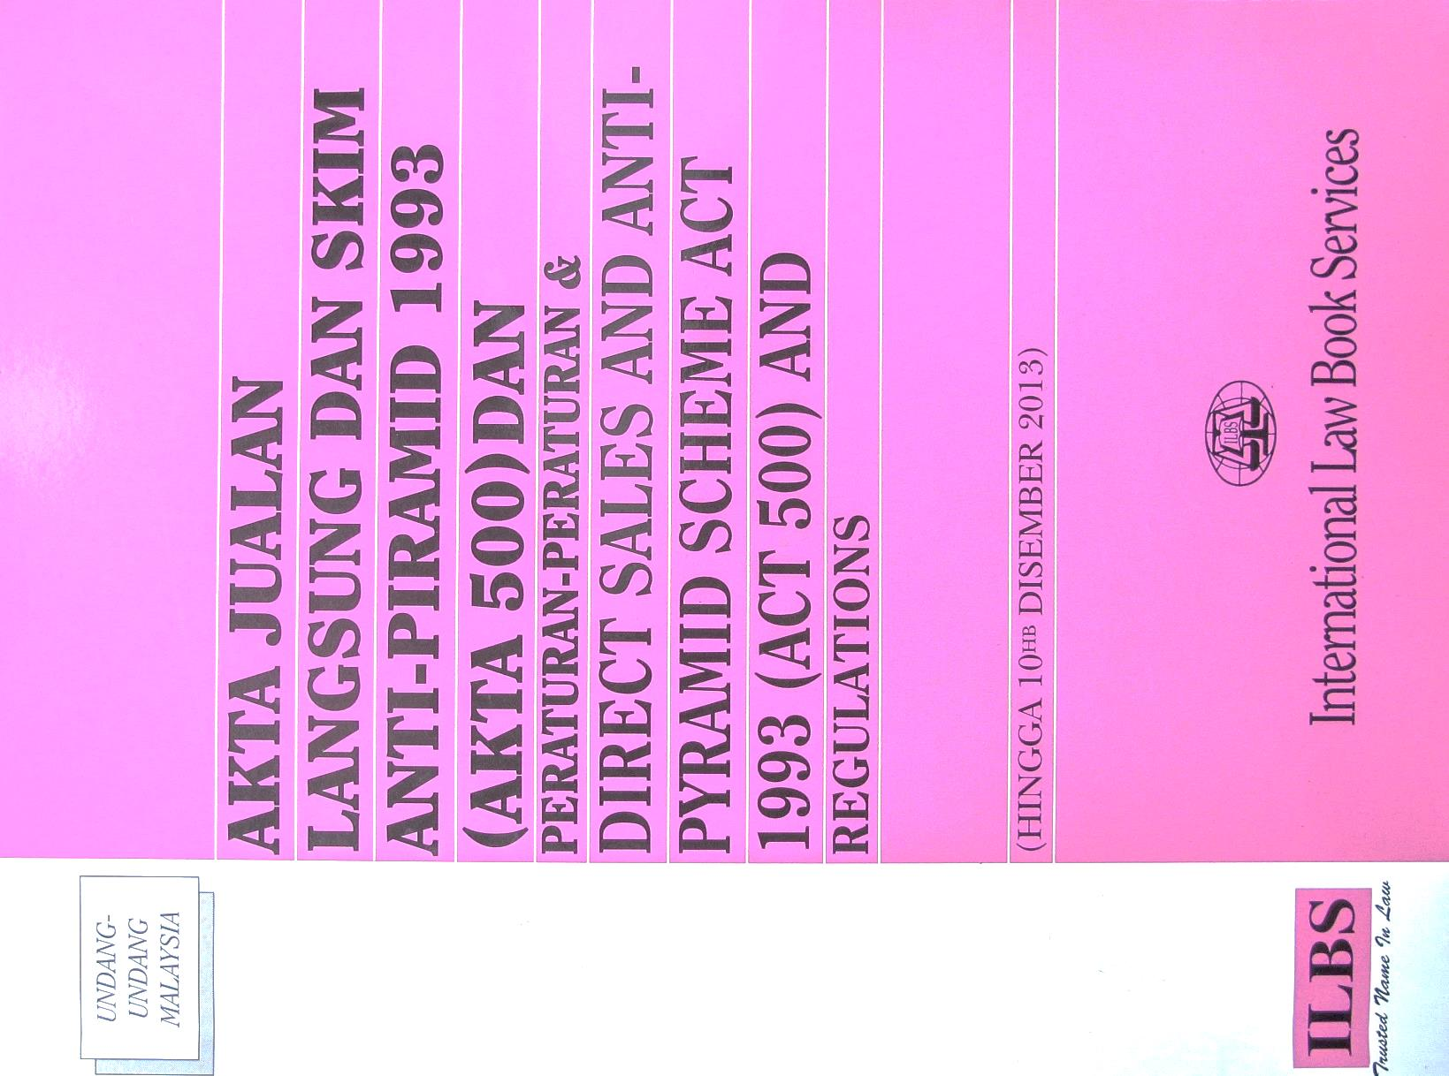
DIRECT SALES AND ANTI-PYRAMID SCHEMES ACT 1993
Regulated by the Direct Sales Act 1993
Amended in 2012 with the addition of the Anti-Pyramid Schemes Act
member of

Slide 38
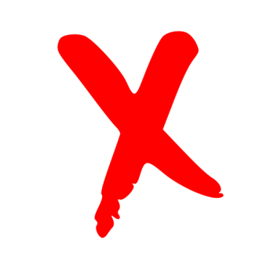
DIFFERENCE BETWEEN DIRECT SELLING AND PYRAMID SCHEMES
Primary income earned from sale of products
Products and services form the backbone of the company
A contract signed between Company and Distributors plus elaborate training programs
Mandatory purchases, deposits, minimum payments, and others are not required
Primary income earned from recruitment
Importance of products and services are not significant
No written contracts or agreement provided to participants
Mandatory purchase of goods, services, deposits or minimum payment in order to join
Direct
Selling
Investment
Schemes
Direct
Selling
Direct Selling
Pyramid
Schemes
Scams
member of

Slide 39
DIFFERENCE BETWEEN DIRECT SELLING AND PYRAMID SCHEMES
DIFFERENCE BETWEEN DIRECT SELLING AND PYRAMID SCHEMES
ASEAN DSAs PRESIDENTs WORKING COMMITTEE
Forced or pressured purchased are prohibited.
Cooling Off period and refund policy available for Consumers
Buy Back policy available for Distributors
Withdraw at any time
Position buying and investment strictly prohibited.
Purchase unreasonable amount
No refund policy for consumers
No Buy Back Policy for Distributors
Difficulty in withdrawal
Buying of positions
Direct
Selling
Investment
Schemes
Direct
Selling
Direct Selling
Pyramid
Schemes
Scams
member of

Slide 40
AGENDA
Introduction and what is Direct Selling?
Direct Selling overview?
Direct Selling
the original
social network
The Direct Selling Association
of Malaysia (DSAM)
Threats to Direct Selling
The Malaysian Experience
How to identify an Illegal
scheme
Question & Answers
member of

